Slide 1

Read and write data from Excel using POI

Slide 2
Introduction
Data Driven Testing is a Test design and execution strategy where the test scripts read test data from data sources (file or database).
Apache POI is the most commonly used API for Selenium data driven tests.
POI is a set of library files that gives an API to manipulate Microsoft documents like .xls and .xlsx.
POI helps to read and write data into Excel.

Slide 3
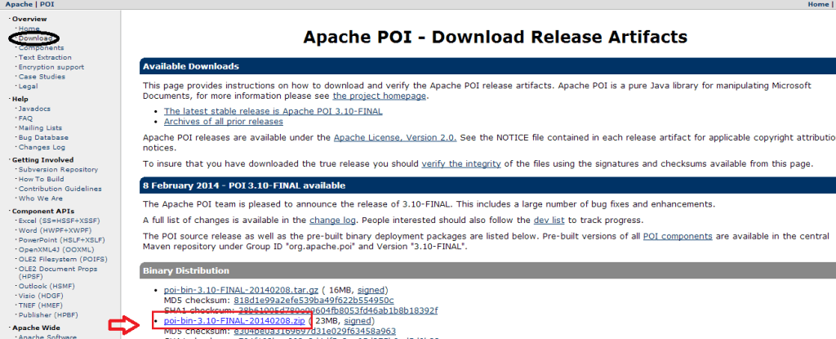
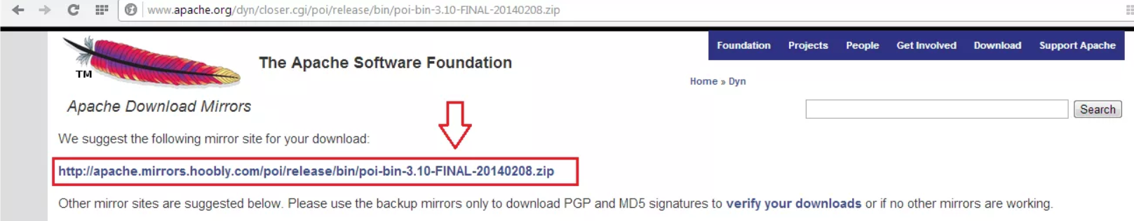
Download apache POI jar file
Step 1) Go to Official website of Apache POI and Click on the download section.
Now Click on the below mention link:-

Slide 4
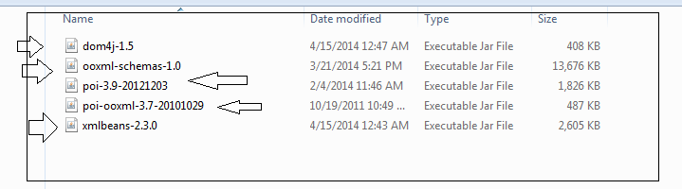
All jar files will come in zip files, Extract it and get final jar folder looks this
Step 2) Add Jar files
Select project then Right click on project > Build path > Configure build path> Click on lib section > Add external jar

Slide 5
Classes and Interfaces in POI
Following is a list of different Java Interfaces and classes inPOIfor reading XLS and XLSX file:-
Workbook: XSSFWorkbook and HSSFWorkbook classes implement this interface.
XSSFWorkbook: Is a class representation of XLSX file.
HSSFWorkbook: Is a class representation of XLS file.
Sheet: XSSFSheet and HSSFSheet classes implement this interface.
XSSFSheet: Is a class representing a sheet in an XLSX file.
HSSFSheet: Is a class representing a sheet in an XLS file.
Row: XSSFRow and HSSFRow classes implement this interface.
XSSFRow: Is a class representing a row in the sheet of XLSX file.

Slide 6
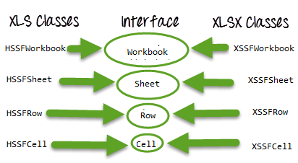
9) HSSFRow: Is a class representing a row in the sheet of XLS file.
10) Cell: XSSFCell and HSSFCell classes implement this interface.
11) XSSFCell: Is a class representing a cell in a row of XLSX file.
12) HSSFCell: Is a class representing a cell in a row of XLS file.

Slide 7
Write data from Excel using POI
Create an xlsx file and save it at particular location.
Enter some data to read using Selenium.
Close the created excel file before executing the script.
Go to option “Format Cells” and under Number Tab option, select Text and click on OK. By default it will be general,so need to make it as Number. If it don’t make as text, there is a chance of NullPointerException error.
Now see the code in next slide:-

Slide 8
package softwareTestingMaterial;
import java.io.FileInputStream;
import java.io.FileNotFoundException;
import java.io.FileOutputStream;
import java.io.IOException;
import org.apache.poi.ss.usermodel.Cell;
import org.apache.poi.ss.usermodel.Row;
import org.apache.poi.xssf.usermodel.XSSFSheet;
import org.apache.poi.xssf.usermodel.XSSFWorkbook;
public class WriteExcel {
public static void main (String [ ] args) throws IOException{
//create an object of Workbook and pass the FileInputStream object into it to create a pipeline between the sheet and eclipse.
FileInputStream fis = new FileInputStream("D:\\Test.xlsx");
XSSFWorkbook workbook = new XSSFWorkbook(fis);
//call the getSheet() method of Workbook and pass the Sheet Name here.
//In this case I have given the sheet name as “TestData”
//or if you use the method getSheetAt(), you can pass sheet number starting from 0. Index starts with 0.
XSSFSheet sheet = workbook.getSheet("TestData");

Slide 9
Console Output:-
//XSSFSheet sheet = workbook.getSheetAt(0);
//Now create a row number and a cell where we want to enter a value.
//Here im about to write my test data in the cell B2. It reads Column B as 1 and Row 2 as 1. Column and Row values start from 0.
//The below line of code will search for row number 2 and column number 2 (i.e., B) and will create a space.
//The createCell() method is present inside Row class.
Row row = sheet.createRow(1);
Cell cell = row.createCell(1);
//Now we need to find out the type of the value we want to enter.
//If it is a string, we need to set the cell type as string
//if it is numeric, we need to set the cell type as number
cell.setCellType(cell.CELL_TYPE_STRING);
cell.setCellValue("SoftwareTestingMaterial");
FileOutputStream fos = new FileOutputStream("D:\\Test.xlsx");
workbook.write(fos);
fos.close();
System.out.println("END OF WRITING DATA IN EXCEL");
}
}
END OF WRITING DATA IN EXCEL

Slide 10
Read data from Excel using POI
Create an xlsx file and save it at particular location.
Enter some data to read using Selenium.
Close the created excel file before executing the script.
Go to option “Format Cells” and under Number Tab option, select Text and click on OK. By default it will be general,so need to make it as Number. If it don’t make as text, there is a chance of NullPointerException error.
Now see the code in next slide:-

Slide 11
Console Output:-
package softwareTestingMaterial;
import java.io.FileInputStream;
import java.io.FileNotFoundException;
import java.io.FileOutputStream;
import java.io.IOException;
import org.apache.poi.ss.usermodel.Cell;
import org.apache.poi.ss.usermodel.Row;
import org.apache.poi.xssf.usermodel.XSSFCell;
import org.apache.poi.xssf.usermodel.XSSFRow;
import org.apache.poi.xssf.usermodel.XSSFSheet;
import org.apache.poi.xssf.usermodel.XSSFWorkbook;
//How to read excel files using Apache POI
public class ReadExcel {
public static void main (String [ ] args) throws IOException{
//I have placed an excel file 'Test.xlsx' in my D Driver
FileInputStream fis = new FileInputStream("D:\\Test.xlsx");
XSSFWorkbook workbook = new XSSFWorkbook(fis);
XSSFSheet sheet = workbook.getSheetAt(0);
//I have added test data in the cell B as "SoftwareTestingMaterial"
//Cell B = row 1 and column 1. It reads first row as 0 and Column A as 0.
Row row = sheet.getRow(1);
Cell cell = row.getCell(1);
System.out.println(cell);
System.out.println(sheet.getRow(1).getCell(1));
} }
SoftwareTestingMaterial

Slide 12
Covered Till Now
Excel file can be read by Java IO operation. so need to use Apache POI Jar.
There are two kinds of a workbook in Excel file, XLSX and XLS files.
POI has different Interfaces Workbook, Sheet, Row, Cell.
These interfaces are implemented by corresponding XLS (HSSFWorkbook, HSSFSheet, HSSFRow, HSSFCell) and XLSX (XSSFWorkbook, XSSFSheet, XSSFRow, XSSFCell) file manipulation classes.

Slide 13
Thanks

